Slide 1


MAXHUB WT15
Wireless Screen Sharing
Dongle

Slide 2
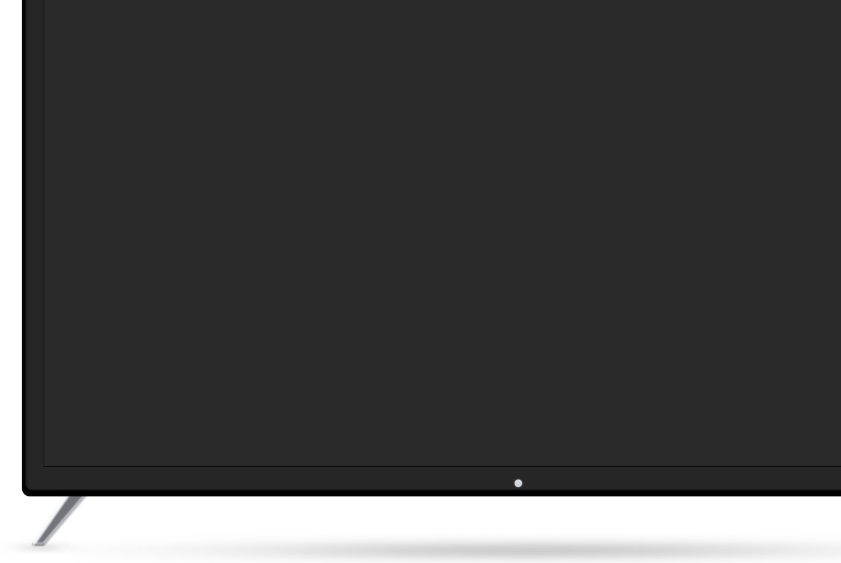

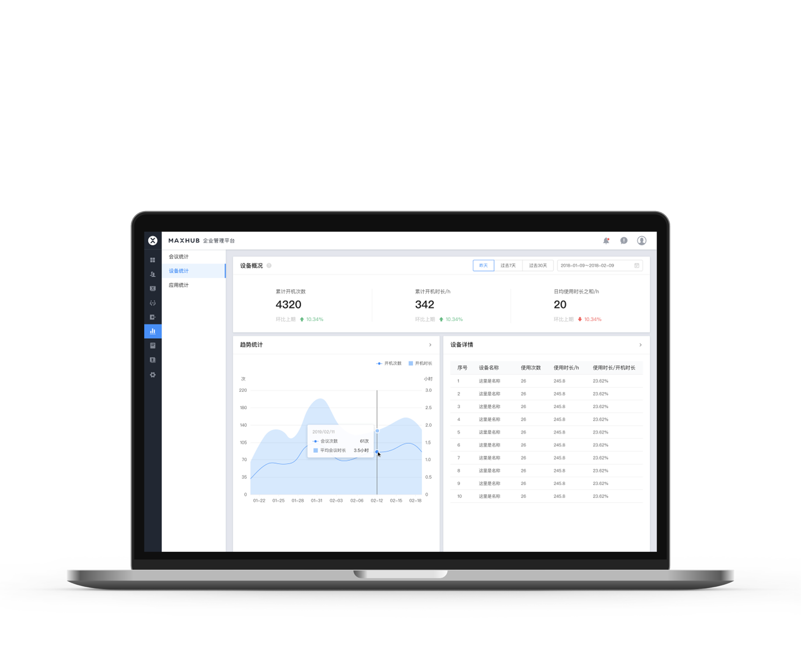
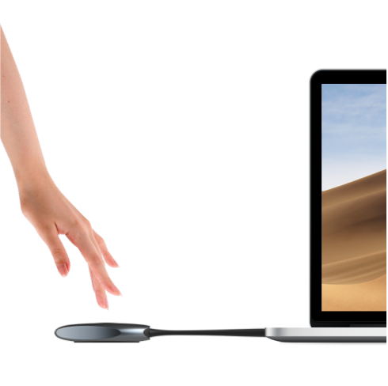
Feature Highlight | 4K Screen Sharing
4K@30fps Screen Sharing, Ultra-low Latency
Supports up to 4K resolution at 30fps, delivering high-definition presentation of meeting content.
Ultra-low latency of ≥90ms ensures a smooth and efficient screen sharing experience.

Slide 3

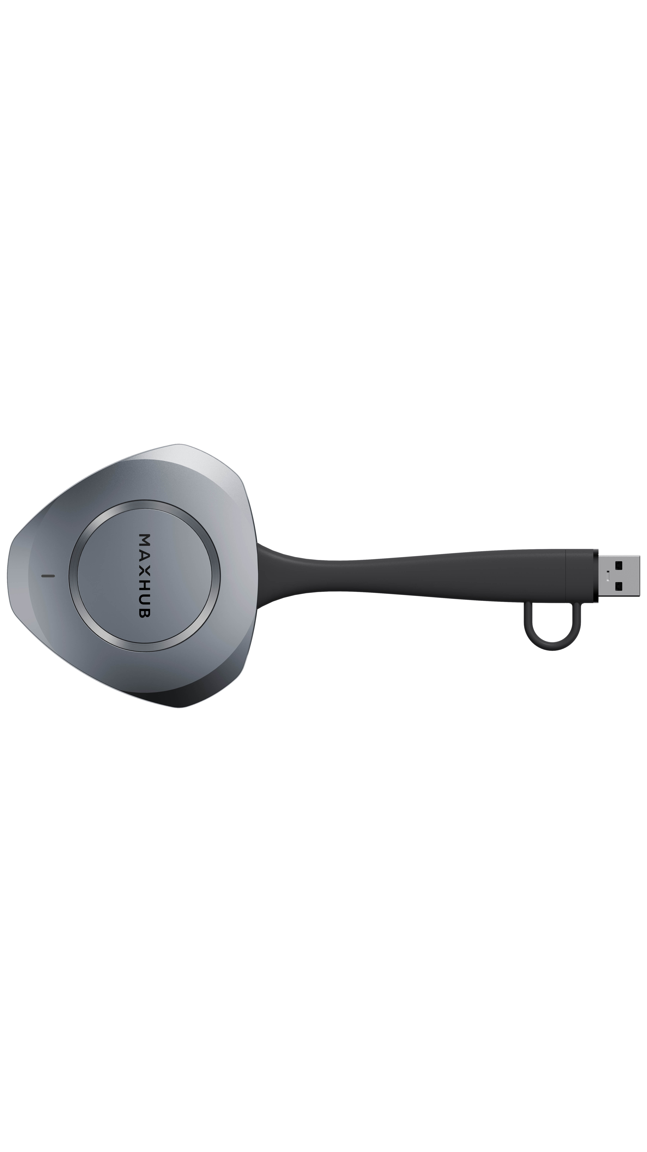
Feature Highlight | 3-Second Plug and Play
Plug and Play, Ready to Share in 3 Seconds
Ready for screen sharing in just *3 seconds after plugging into the computer.
The dongle features a built-in auto-start module that pre-launches the program before being plugged in.
*USB-C: ≥3s, USB-A: ≥10s

Slide 4
Feature Highlight | Wireless BYOD
1080P Wireless BYOD Capability
Enables personal devices to wirelessly access the meeting room’s cam, mic, and speaker peripherals.
Hardware decoding for 1080P BYOD delivers 50% higher transmission bitrate and outstanding stability.

Slide 5
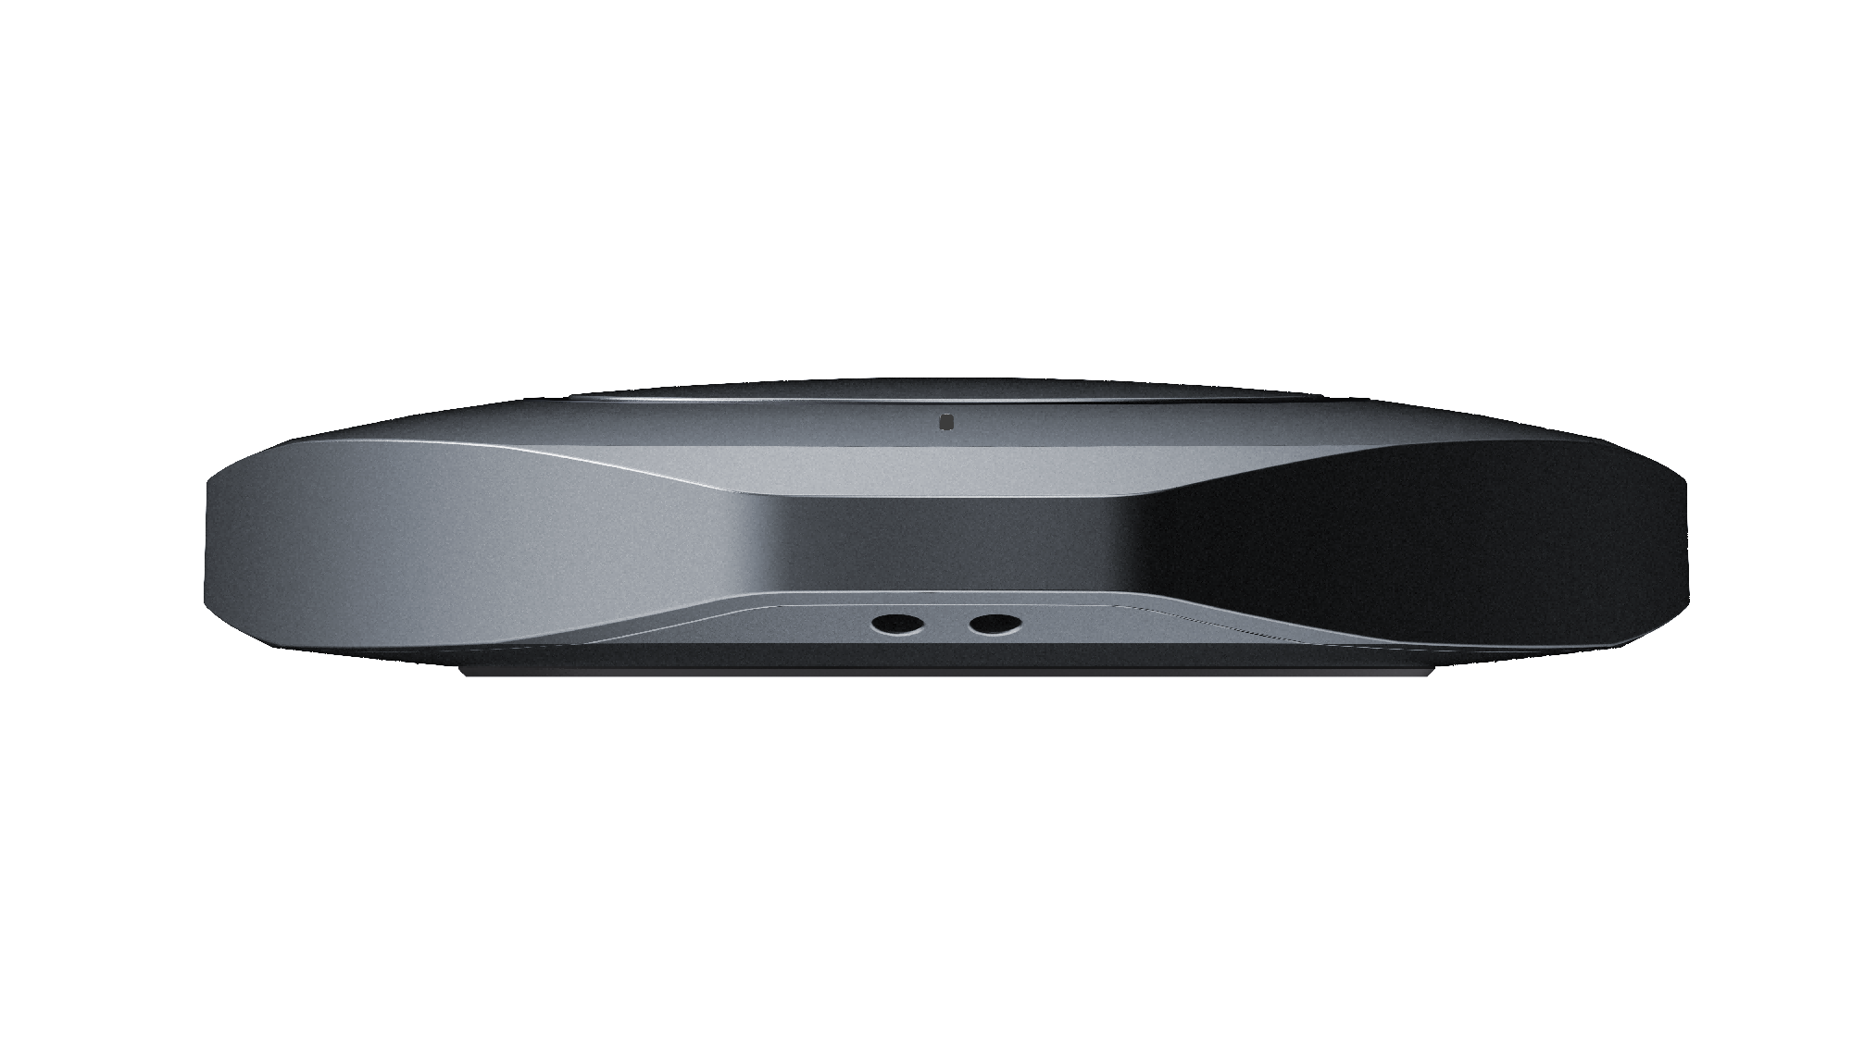
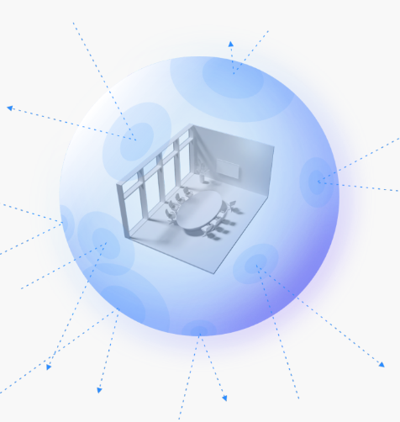
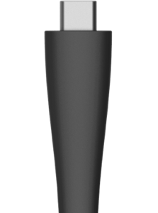
Feature Highlight | Built for Business
Durable Cable and Adapter
Thoughtful Anti-loss Design
Multi-layered Security Encryption
Rigorously tested to withstand over 20,000 bends, ensuring 3X long-lasting performance
Integrated USB adapter, enabling seamless switching between USB-C and USB-A interfaces
The dongle features a dedicated lanyard hole, allowing it to be securely attached to meeting tables or display devices, effectively preventing loss.
Utilizing AES 128-bit encryption algorithms.
Dynamic key negotiation and multi-factor authentication ensure every connection is independently secure

Slide 6
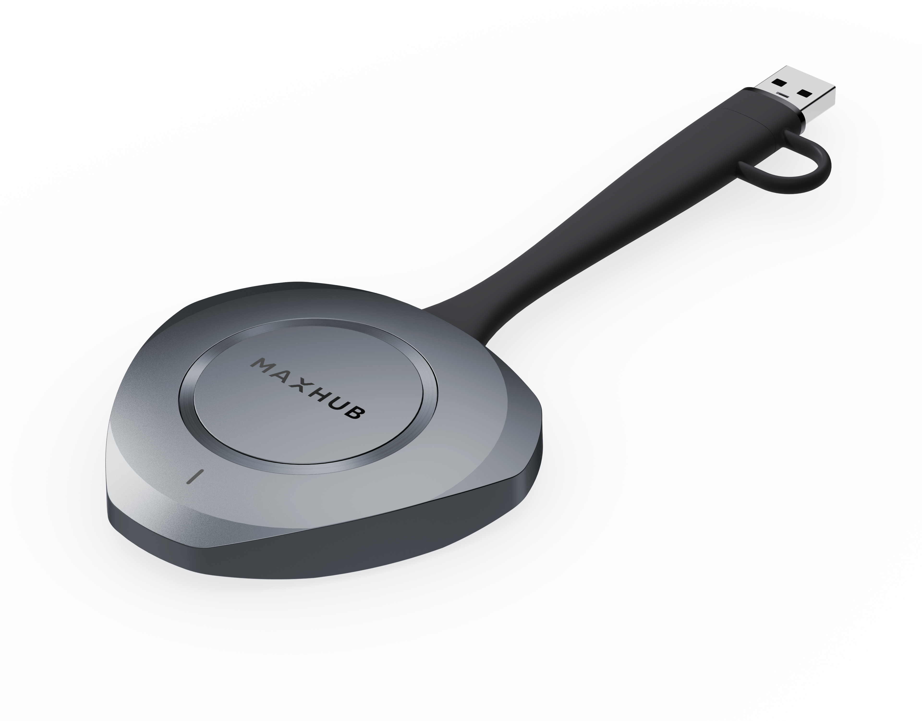
MAXHUB WT15 Wireless Dongle
Specification | MAXHUB WT15
Screen Sharing | 4K @ 30fps 1080P @ 60fps
Wireless BYOD | 1080P @ 30fps
Screen Sharing Latency | ≥90 ms (Min.)
Audio/Video Decode | OPUS/H.264/H.265
Picture Quality and Color | YUV444/YUV420
Devices Connected | Up to 32 devices
Simultaneous Screen Sharing | Up to 9 devices
Connection Distance | Up to 12 meters
Connection Speed | ≥ 3s (USB-C), ≥ 10s (USB-A)

Slide 7
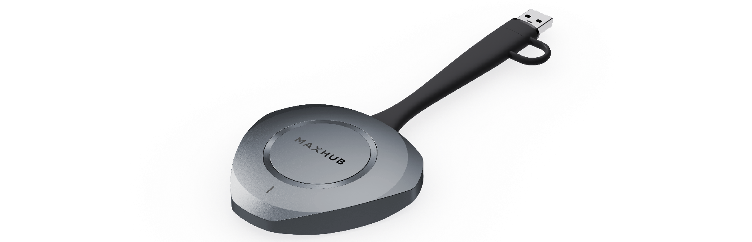
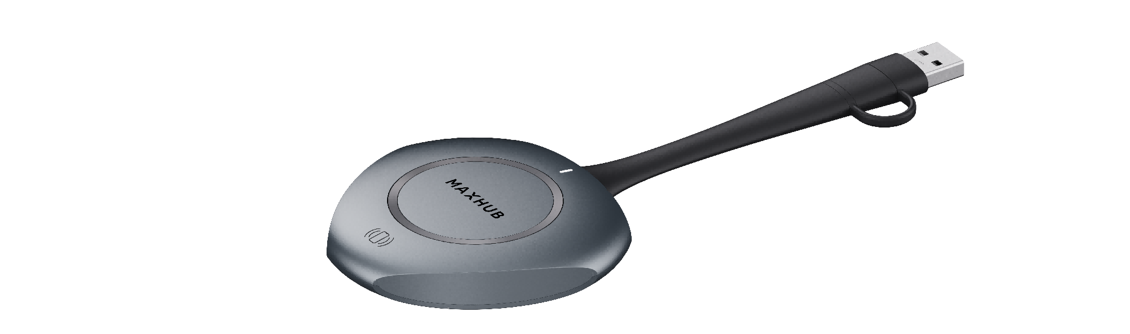
MAXHUB WT15 Wireless Dongle
WT15
WT13
ID Design
Connection Speed
≥ 3 seconds
≥ 5 seconds
Screen Share Latency
≥90ms
≥90ms (USB A), ≥120ms (USB C)
1080P@30fps (Hardware Decode)
36 Mbps (MJPEG)
1080P@30fps (Software Decode)
25 Mbps (MJPEG)
*BYOD Performance
Cable Durability
>20,000 bends
>7,000 bends
Wireless Connection
2T2R, Up to 12 meters
1T1R, Up to 8 meters
Anti-loss design
No Battary
Other Feature
-
*Not available in WT15S and WT13S

Slide 8




Thanks.
www.maxhub.com
MAXHUB
sales@maxhub.com

